Slide 1


WiFiMon: Overview & Results from Symposium Pilot
Pavle Vuletić, UoB/AMRES
Kurt Baumann, SWITCH
Nikos Kostopoulos, NTUA/GRNET
Network Monitoring Session
Ljubljana, Slovenia 4-5 February 2020

Slide 2

Outline
WiFiMon Overview
Introduction
Data Flow
Data Collection Technology
Hardware Probes
WiFiMon Pilot in GÉANT Symposium
Conclusions
Summary
Looking Ahead

Slide 3
WiFiMon: Introduction
Mission Statement:
“…Is it possible to gather data from multiple sources, including browser-based measurements, in addition to traditional monitoring, and extract meaningful information on the performance of a WiFi network from that data?…”
Determine how end-users experience WiFi at a given place on the network, at a given time.
HW probes collect performance measurements but are installed at fixed locations. Crowdsourced measurements are also required.
Notes:
Generic statement:
Gather data from multiple sources,
Browser based measurement in addition to traditional monitoring
Extract Data: Accurate enough so that we can propagate a “Performance statement for a WiFi campus”

Slide 4
WiFiMon - Data Flow
Real Time Analysis:
- Performance Data Parsing
Correlation of Performance Data with RADIUS-Accounting Data
PERFORMANCE DATA
ANALYZE DATA
IEEE802.1X / eduroam enabled infrastructures:
- End-users: Smartphones, Laptops - Hardware Probes
Filtered RADIUS
Logs
Correlation Results
ACCOUNTING DATA
STORE DATA
CONSUME & VISUALIZE DATA
RADIUS Logs:
- Data Filtering (Logstash)
Data Storage (Elasticsearch) - Filtered RADIUS Logs - Correlated Results: Performance Data correlated with RADIUS Logs
WiFiMon GUI:
- Visualization (Kibana)
- User Options
4
Notes:
The aim of our approach is to record network performance measurements by using collected raw data (data source) on WiFi and to visualize them. Temporary Data – Raw data from the data source
Persistent Data – Correlated data
==========
Only correlated data will be stored and analysed
Mobility prediction and focus is possible, so the correlation with the AP helps us to provide a localized statement to the network performance.
==========
The Web-User Interface is the Network Administrators view, about their own data. In our concept use Kibana (for visualization) and Elasticsearch (as a DB).
It is worth mentioning that previous WiFiMon versions used Grafana/InfluxDB and PostGresql

Slide 5
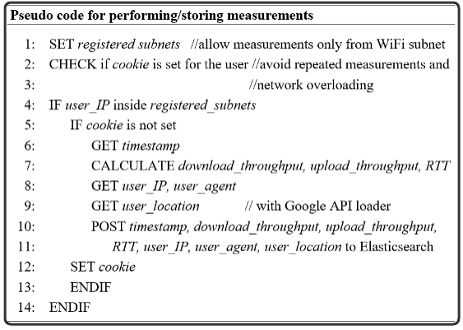
WiFiMon - Performing / Storing measurements
Network Overloading Avoidance:
Measurements accepted only from registered subnets
Cookie: repeated measurements in short time intervals are not permitted
Notes:
To the 2nd step - performing and storing of measurements at the database:
Per configuration:
Sub-Net defined => Measurements only from the sub-nets
Check is Cookie set, YES/NO => Expiration time after the measurements done – 1.5’

Slide 6
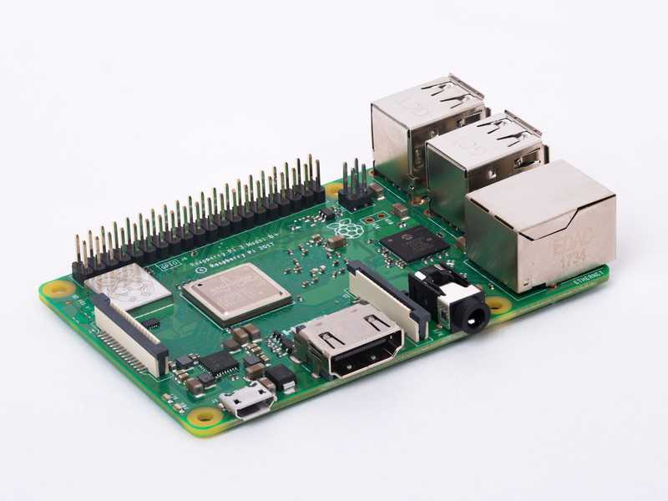
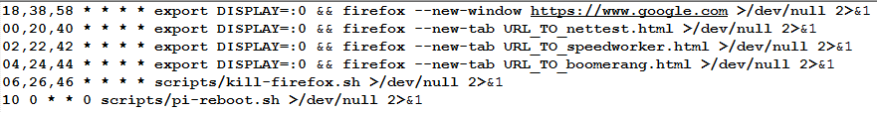
WiFiMon – Hardware Probes
Hardware Probes:
A Raspberry Pi 3 Model B+
A micro SD card with at least 16GB size
WiFiMon Raspberry Pi operating system image
(Size ~ 3.6 GB)
Indicative crontab:

Slide 7
WiFiMon Pilot in GÉANT Symposium
GÉANT Symposium 2020 – Ljubljana, Slovenia:
Crowdsourced measurements,
JS lines added in the Symposium Agenda
Deterministic measurements,
7 Hardware Probes, 5 min measurement interval

Slide 8
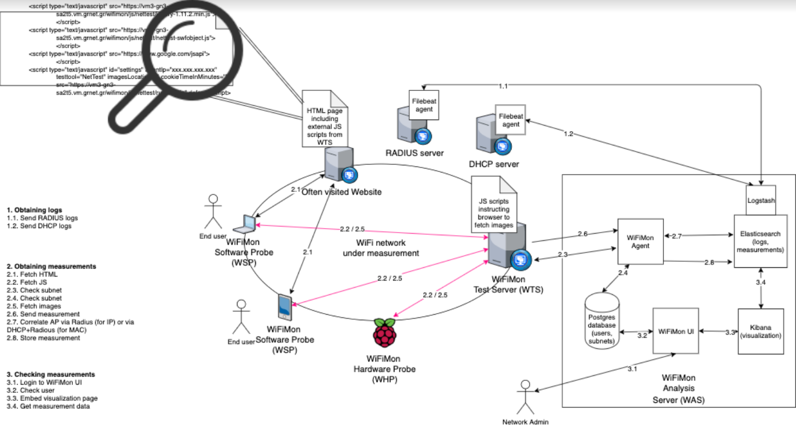
Architecture
WiFiMon Components:
- WiFiMon Software Probe (WSP) - WiFiMon Test Server (WTS)
- WiFiMon Hardware Probe (WHP) - WiFiMon Analysis Server (WAS)
8
Notes:
What we see on the picture: You have end-user devices with laptops, smartdevices and Hwprobes in our case RasPi on the WiFi-Network
Webserver / WiFiMon Prob Server / WiFiMon Analysis Server.
As a pre-process we have the authN/Z on a IEEE802.1X/Radius which comes up with IDP/SP Radius Logs.
To guaranty the Radius privacy (schematically shown in the next slide) a Filebeat agent is install for filtering
the RADIUS logs and Location information according our specification – This data will be feeded to Logstash, encrypted and
sent to the Elasticsearch for indexing.
In the Perfomance Data Process the JS will be fetched and template triggered to measure throughput (Up/Donload speed) and
Latency (Ping) – Instance of implemented JS and Template (NetTest, Boomerang, HTML) could be on one instance.

Slide 9
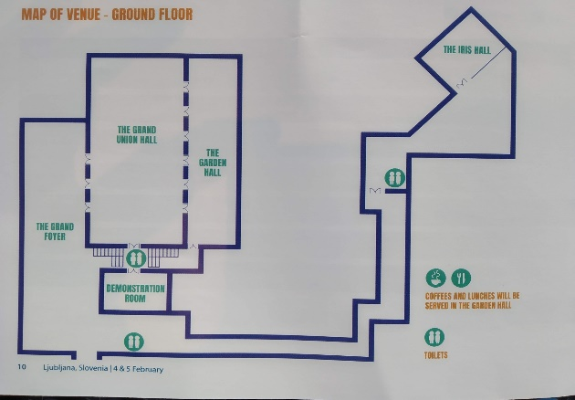
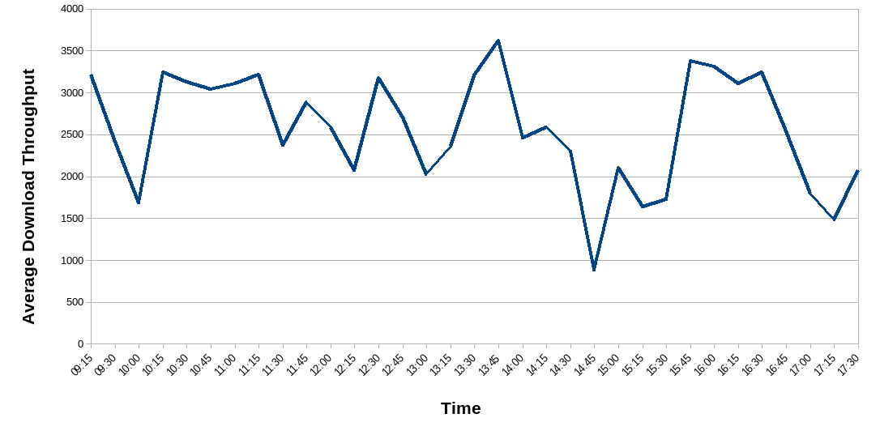
The GRAND FOYER – HWprobe 3
3
WiFiMon can detect WiFi performance degradation
Opening Plenary between 9:00 – 10:15 Coffee break and RARE demonstration between 14:45 and 15:30 People move from the Grand Union Hall to the GRAND FOYER after evening plenary
Better performance when people are in the sessions (away from APs nearby the probe)

Slide 10

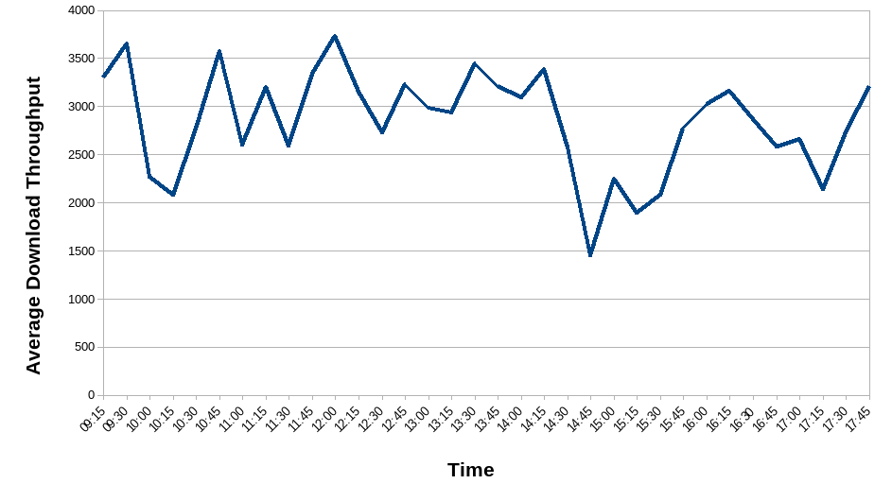
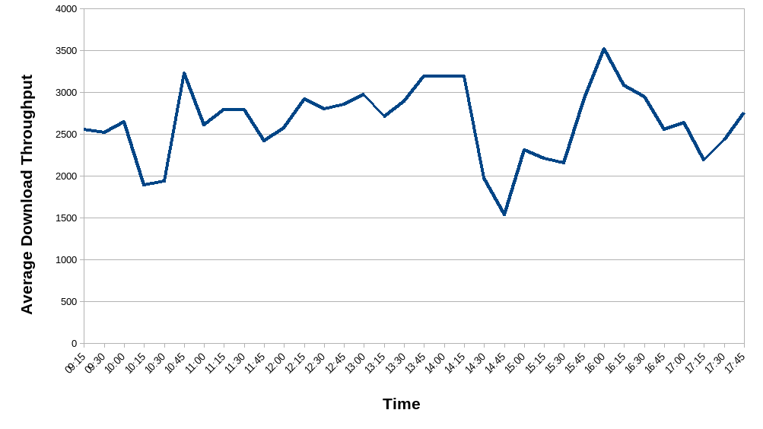
GRAND UNION HALL – Probe 2 (next to stage) & Probe 5 (back entrance)
2
5
WiFiMon can detect WiFi performance degradation
Opening Plenary between 9:00 – 10:15 People gathering for evening sessions and plenary in the Hall between 14:00 – 17:00
Both probes in the room follow the same patterns in WiFi performance drops

Slide 11
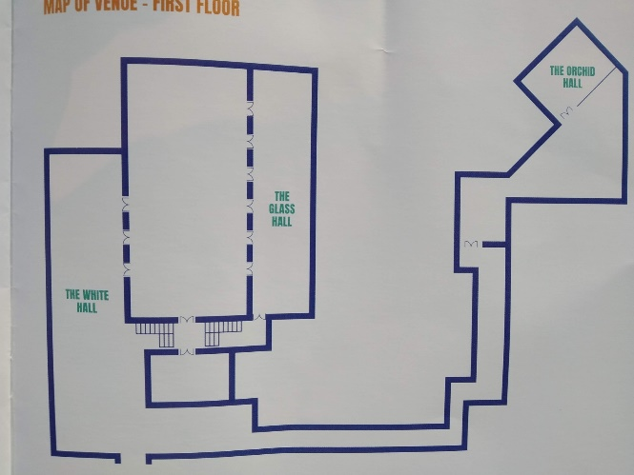
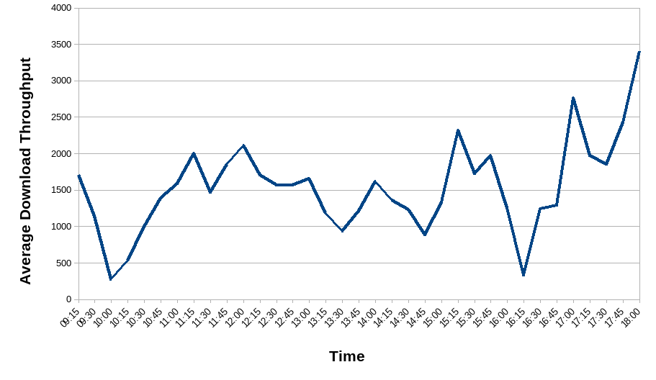
1st Floor Balcony - HW Probe 4
4
WiFi performance drops during opening and evening plenaries

Slide 12
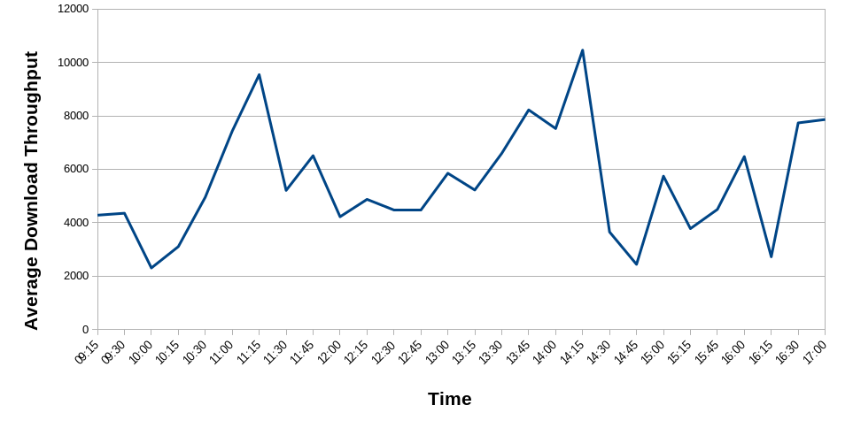
Crowdsourced Measurements
Crowdsourced measurements follow the same trends with deterministic ones
Presumably, people visit the Symposium agenda when the new sessions start

Slide 13
Correlation with Wireless Metrics from HW Probes
HW Probe | Signal Level | Bit Rate | Link Quality | TX Strength | Download Throughput (KBps) | Upload Throughput (KBps) | Ping Latency (msec)
1 | -55 | 65 | 60 | 31 | 1000 - 3000 | 500 – 1500 | 30
2 | -51 | 55 | 57 | 31 | 2000 – 3000 | 1000 – 2000 | 20
3 | -56 | 72 | 53 | 31 | 2000 – 3000 | 1000 – 2000 | 20
4 | -57 | 52 | 53 | 31 | 1000 – 2000 | 500 – 1500 | 30
5 | -65 | 78 | 44 | 31 | 2000 – 3000 | 1000 – 2000 | 25
6 | -63 | 65 | 47 | 31 | 1000 – 3000 | 500 – 1500 | 30
7 | -55 | 65 | 55 | 31 | 2000 -3000 | 1000 - 2000 | 30
Throughput measurements do not necessarily follow the trends or Wlan metrics
- HW Probe 1 has the best link quality, but lower throughput - HW Probe 5 has lower link quality, but better throughputs
Deterministic and Crowdsources measurements are essential to reach conclusions about WiFi performance

Slide 14
Future Work
Test WiFiMon in Campus Networks
Push WiFiMon towards becoming a service
Combine measurements from multiple probes located in the same room

Slide 15

Thank you
Any questions?
gn4-3-wp6-t3-wifimon@lists.geant.org
As part of the GÉANT 2020 Framework Partnership Agreement (FPA), the project receives funding from the European Union's Horizon 2020 research and innovation programme under Grant Agreement No. 856726 (GN4-3).​​​

